Slide 1
Automated Functional Testing
Using Selenium IDE to create functional tests

Slide 2
What is Selenium?
“Selenium is a popular open-source web-based automation tool”
Translation: Selenium is:
For creating automated tests by simulating user interactions with the application under test
Free

Slide 3
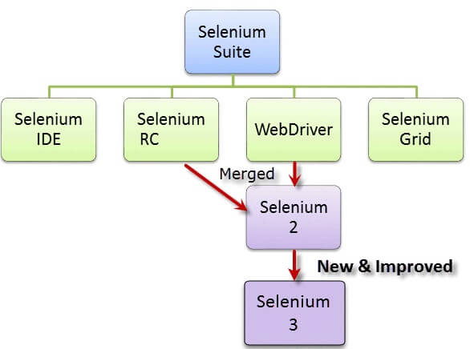
What is Selenium? (2)
Selenium comes in multiple forms
Selenium IDE
Selenium WebDriver
Selenium Grid
IDE: record tests graphically
WebDriver: write test scripts in Java*
Grid: run tests in parallel

Slide 4
Introducing Selenium IDE
Selenium IDE is a Chrome plugin for linear scripting
Recall: linear scripting has test case data hard-coded into the test scripts
It allows you to record test scripts through:
Recording interactions with a browser tab
Adding verifications/assertions to confirm expected outputs

Slide 5
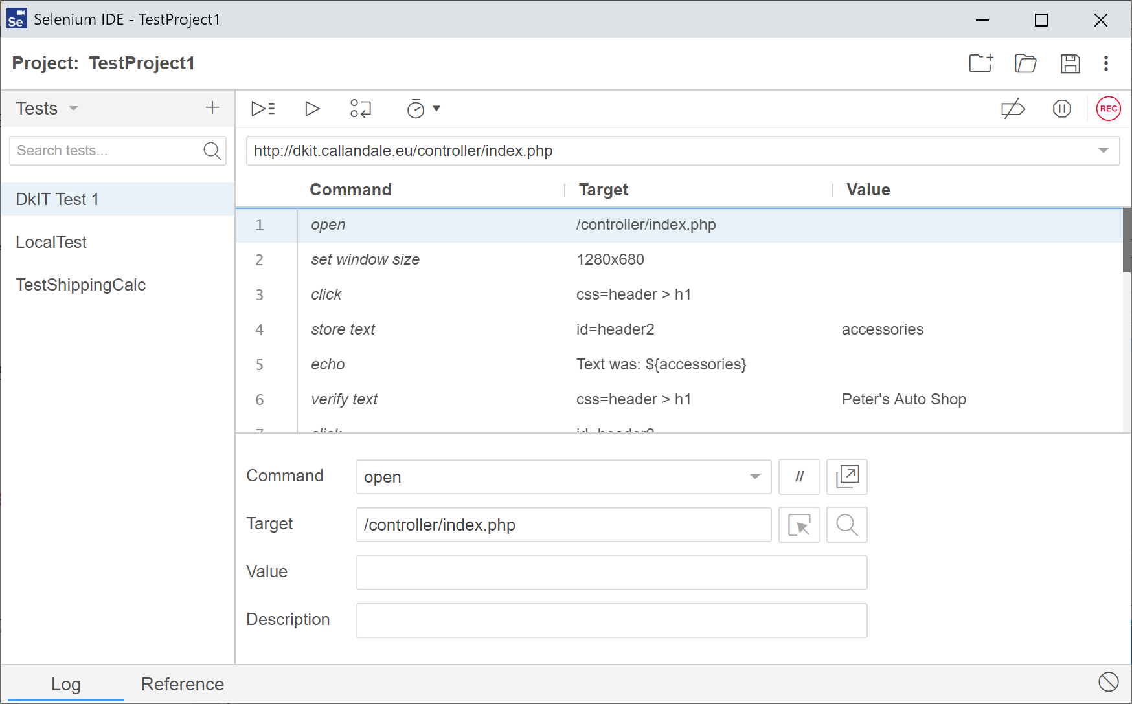
The Selenium IDE GUI
Start recording a test (this changes to a stop button when a test is recording)
Run this test
List of tests in the current project
Toggle test breakpoints on/off
Sequence of actions (and their component information) making up the test
Command/action to be added (dropdown)
What part of the page the action should be done to (the locator)
Log of events occurring during the test run
What information should be used for the action

Slide 6
Commands – You Want to Do What?
Selenium comes with a drop-down of actions you can carry out (i.e. Commands)
Each action represents one of the following:
A step in your test script
A value being stored to be checked
An assertion on a value
These actions are carried out on specific elements in the page being tested
Need to be able to specify which elements we mean

Slide 7
Targets: You Want to Do What to Which?
Selenium tests are based on:
Interacting with websites to provide input
Asserting that this input produces expected results
We need to be able to identify specific components (elements) of a webpage in order to:
Provide them with appropriate inputs
Assert that they contain our expected results
This is achieved through the use of locators (entered in the target field)
This need emphasises why we should label the contents of our webpages when developing them!

Slide 8
Locators: Uniquely Identifying Page Elements
Locator: a way Selenium can uniquely identify an element on a web page
Some common types of locator:
ID, Name, Linktext, Tag Name, Class Name, DOM locator, CSS selector
Locator syntax depends on the type of locator used
Generally, syntax is locatorType=text
Best locator type is id as it’s unique
Use @ to identify an attribute of an element
E.g. id=firstNameField@size would be used to locate the size of the firstNameField text box

Slide 9
Values: It Should Be What?
When we deal with inputs and expected outputs, we have specific information we need to use
This comprises the contents of the Value field
When entering input, the data being entered is placed in the Value field
When asserting a specific expected result is present, the expected result data is placed in the Value field

Slide 10
Creating a Selenium Test
Before starting to record a selenium test you should know:
The URL of the page you wish to test (don’t forget to include http://)
Note: This can be a local page, it does not need to be hosted remotely to work
The steps required for the test logic to be carried out
The appropriate inputs and corresponding expected outputs
Good practice:
Script the tests in advance
Don’t start recording before you have your test plan created with all scripts for a particular feature
I.e. write your Gherkin feature files!

Slide 11
Scripting a Test – The Basics
Fill in the “base URL”, i.e. on what page the test should begin
Click “Start Recording” (the “Rec” symbol in the top right)
Selenium should open a new browser window showing the base url you specified at the start
A graphic saying “Selenium IDE is recording…” should appear in red, along with a pulsing red dot
Interact with the page as normal to carry out the logic of your test case

Slide 12
Scripting a Test – Making Assertions
To make an assertion:
In the IDE, choose the appropriate assertion type from the drop down list of commands
In the target field, enter the locator of the element you’re making the assertion about
Remember, the best choice for a locator is its id
If you need your target to have a specific value as part of your assertion (i.e. if there’s specific text as the expected result), enter it in the value field
Fill in a description of what the assertion is checking (this is just a comment for the tester)

Slide 13
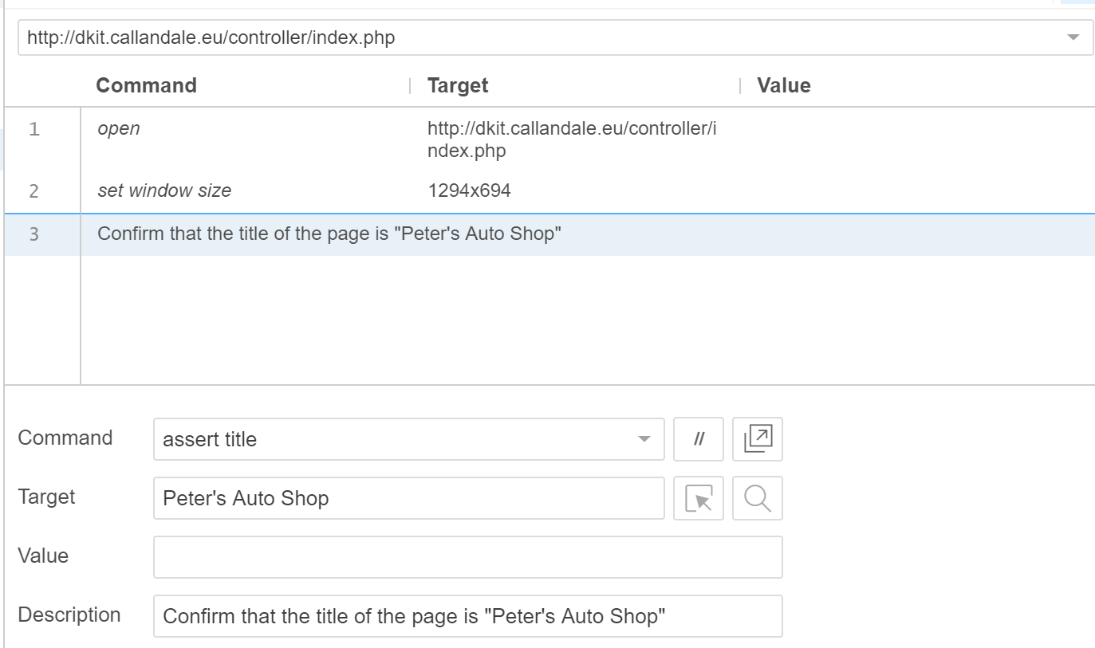
Making an Assertion – An Example
Assertion: Confirm the title of the page is set correctly
How could this be useful?

Slide 14
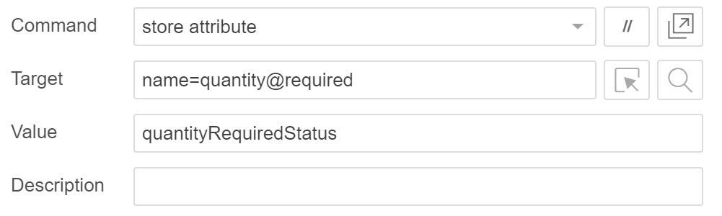
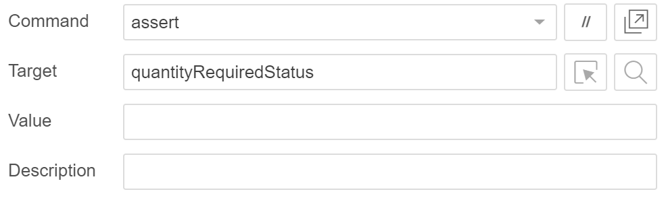
Example of Making a More Complex Assertion
A more complicated assertion is that a field is required
To achieve this:
Store the required attribute of the field that should be required
Assert that the stored value is blank
If it doesn’t exist, i.e. the field is not required, this assertion will fail

Slide 15
Resources
Guru99 contains many tutorials and articles on Selenium in its various forms:
https://www.guru99.com/introduction-to-selenium.html
Walkthrough tutorial on getting started with Selenium:
https://testguild.com/selenium-ide-guide/
Run-through of locators in Selenium:
https://www.lambdatest.com/blog/locators-in-selenium-webdriver-with-examples
Useful link on interacting with forms in Selenium (includes information on various types of selector):
https://www.lambdatest.com/blog/complete-guide-to-access-forms-in-selenium-with-java/
Useful links on CSS selectors:
https://saucelabs.com/resources/articles/selenium-tips-css-selectors
https://www.w3schools.com/cssref/css_selectors.asp

